Slide 1
Considerations of social compliance audits in the future such as how to get more benefits in terms of learning and improvements from audits and how audits can be expected to develop due to the new EU-legislation
Deep- dive Management system need to be included in the audit process such as policy, procedure, organogram and SOP
More ownership should be given to the supplier i/e before audit i/e internal audit is must
Sample size should be increased in the audit process to find actual scenario of the labour standard
Social impact initiatives needs to incorporate with audit process
Develop CAPs jointly and address risks and concerns about worker well-being
Keep the track of Continual improvement and it’s impact
Include Mid- level management in the auditing system
Unified benchmark for social compliance audit to reduce audit fatigue and to give more ownership to the suppliers

Slide 2
Focused Area
How to ensure data is not corrupted / falsified?
Stronger requirements on accreditation of audit firms
Stronger penalties on audit fraud
Buyers improving their understanding of local context and being more flexible / realistic, and allowing suppliers time to improve
How to facilitate that audits lead to change:
(Some) buyers becoming more sincerely interested improving the ground reality instead of just “ticking the box”
Closer collaboration between buyer and supplier
Buyers connecting purchasing decisions to suppliers HRDD / S&L performance rating (like we are with the 75% target), and taking consequence if supplier doesn’t’ improve.

Slide 3
In the light of the due to diligence, Audit process needs to be improved
Key overview of due diligence process
﻿﻿Due diligence involves multiple processes and objectives
﻿﻿Due diligence can involve prioritization (risk-based)
﻿﻿Due diligence is dynamic
﻿﻿Due diligence does not shift responsibilities.
﻿﻿Due diligence is appropriate to an enterprise's circumstances.
﻿﻿Due diligence is informed by engagement with stakeholders

Slide 4
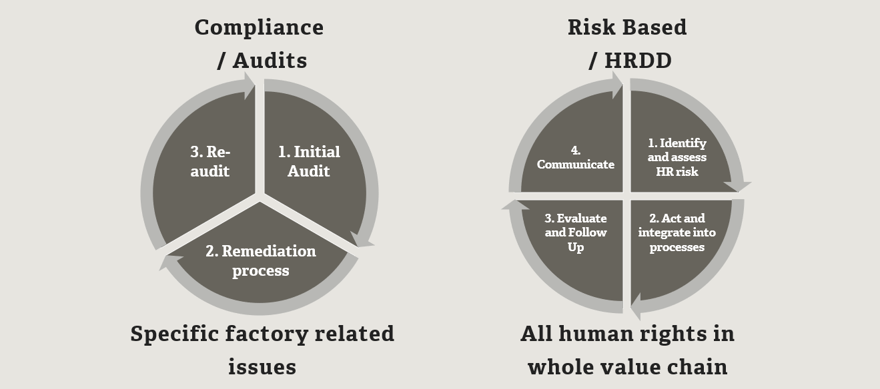
Comparison between Social Compliance & Due Diligence
Social compliance is about ensuring lists are ticked to gain compliance which was limited to assembling supplier, on the other hand, due diligence demands companies identify and assess salient risks across their operations and value chain.

Slide 5
Actual risk assessment process needs to be added in the audit process
Supply Chain Mapping
List the Risk Topics
Identify Adverse Impacts for Each Topic.
Identify Affected Group
Identify Severity of Risk
Identify Probability of Risk
Calculate Risk Priority Number
Justify your Assessment
Prioritize Risk

Slide 6
Thank you

